Slide 1


PROJECT ID:
SWEM-28
Meri Kitab
GROUP MEMBERS:
ROLL#.2K20/SWE/39
HEMRAJ
ASAD SABIR
AIJAZ AHMED SANI
ROLL#. 2K20/SWE/26
ROLL#. 2K20/SWE/18
SUPERVISOR NAME:
ENGR.NOOR-UL-AIN PATOLI
DEPARTMENT OF SOFTWARE ENGINEERING, FACULTY OF ENGINEERING AND TECHNOLOGY, UNIVERSITY OF SINDH, JAMSHORO

Slide 2
INTRODUCTION
Online Book Exchange Platform: Meri Kitab is a pioneering online platform designed to revolutionize the way people buy, sell, exchange, and donate books. Inspired by the rich history of strategic plans like the Population Census, we aim to bring the book commerce experience into the digital age.
Digitalizing Book Transactions: Similar to the digital census initiatives in some countries, Meri Kitab aims to digitalize book transactions, making it easier than ever to find, acquire, or part ways with your beloved books.

Slide 3
Decentralized Approach: In addition to digitalization, we adopt a decentralized approach, ensuring that book lovers across various communities can connect directly, fostering a sense of community and shared knowledge.
User-Centric Experience: Meri Kitab is designed to offer a user-centric experience, allowing book enthusiasts to explore, interact, and access their favorite titles with ease.
Promoting Sustainability: Like the transition from traditional census methods to digital alternatives, Meri Kitab strives to promote the sustainable and cost-effective reuse of books, reducing waste and saving valuable resources.

Slide 4
OBJECTIVES
Facilitate Book Exchange: Enable users to easily buy, sell, exchange, and donate books through a user-friendly online platform, promoting the reuse of books and reducing waste.
Enhance Book Accessibility: Make a wide range of books available to readers, including those that may not be easily found in traditional bookstores, by leveraging the collective bookshelves of individuals.

Slide 5
Foster Sustainability: Promote a mindset of sustainability and cost-effectiveness by encouraging users to engage in the circular economy of books, thereby contributing to environmental conservation and resource preservation.
Empower Communities: Create a network of book enthusiasts and learners who can connect, share knowledge, and strengthen their communities by giving every book a chance to be read, appreciated, and loved.

Slide 6
scope
The initial scope of Meri Kitab is limited to the city of Hyderabad, serving as a localized online marketplace for buying, selling, and exchanging books. However, the long-term vision is to expand and become a nationwide and possibly global platform, transforming the way people access and share literature.

Slide 7
METHODOLOGY
The methodology of Meri Kitab revolves around creating an accessible and sustainable book commerce platform. It entails digitalizing the process of buying and selling books, while also decentralizing the approach, connecting book enthusiasts directly. By leveraging open-source technologies and a user-friendly interface, Meri Kitab aims to offer a seamless experience for users. This involves building and managing a robust online marketplace and facilitating user-to-user interactions for book transactions. The methodology also focuses on promoting eco-consciousness by encouraging the reuse of books, ultimately fostering a sense of community among readers.

Slide 8
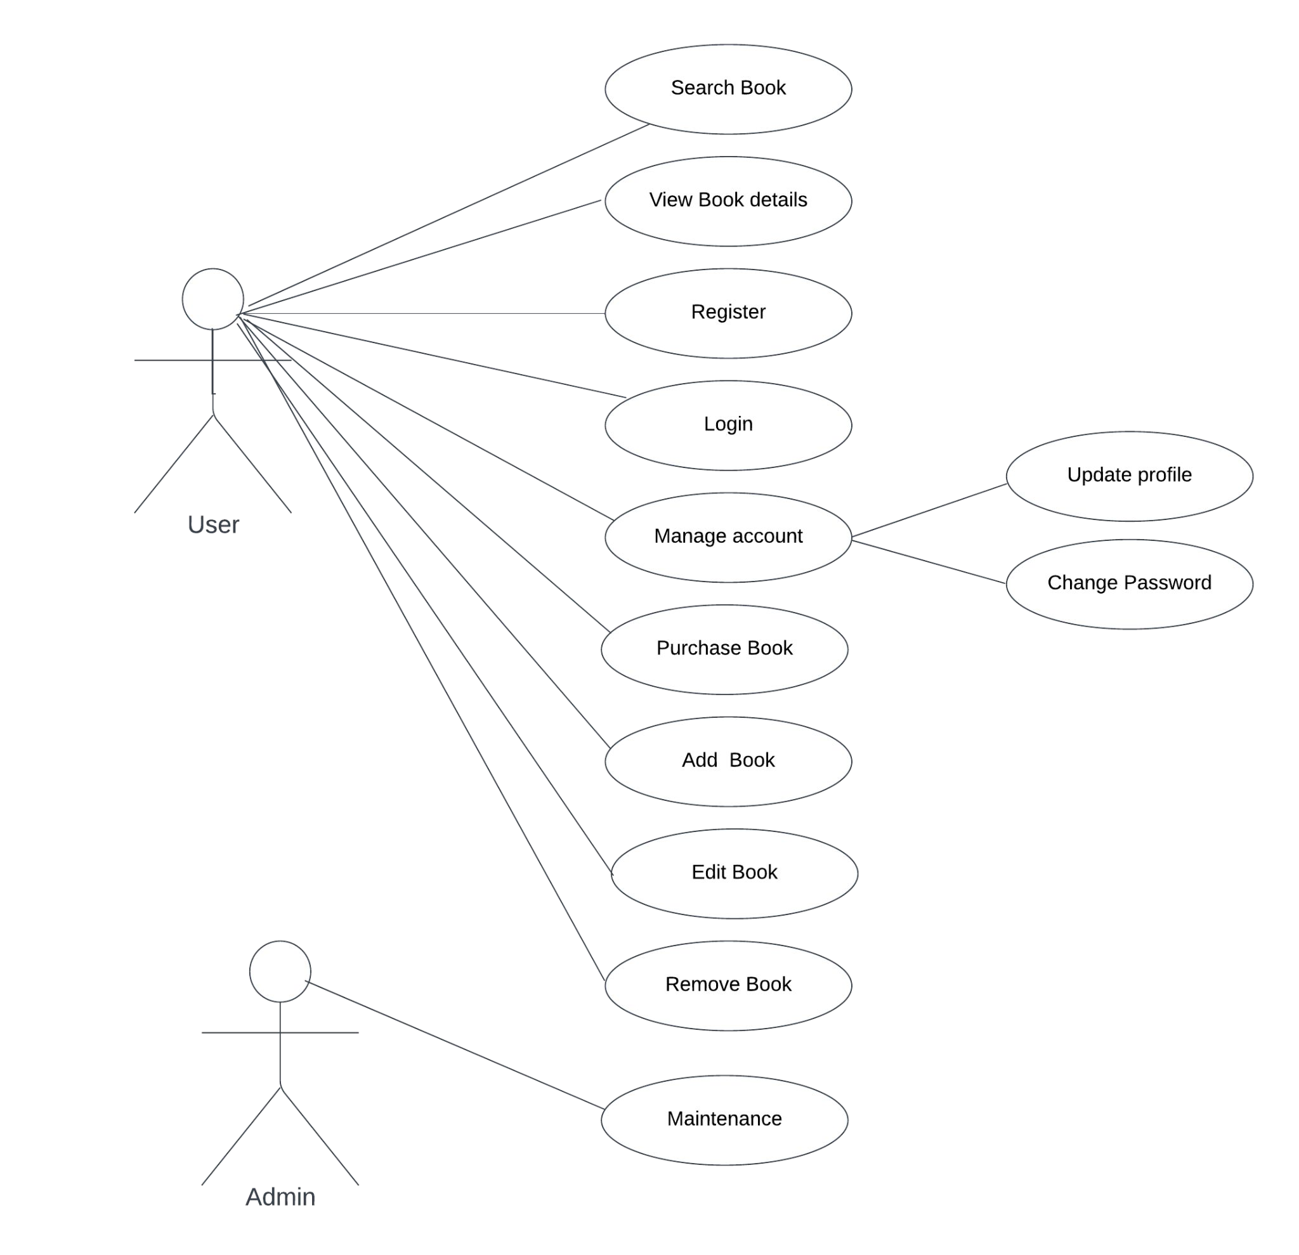
USE CASE DIAGRAM

Slide 9
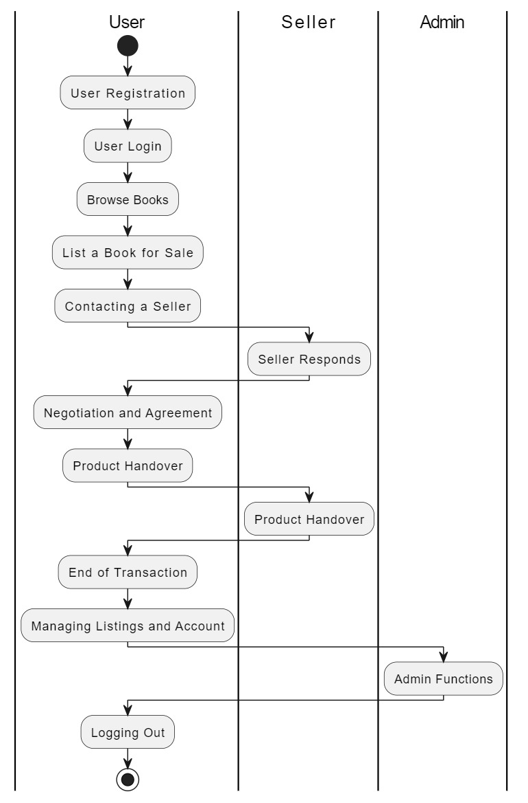
ACTIVITY DIAGRAM

Slide 10
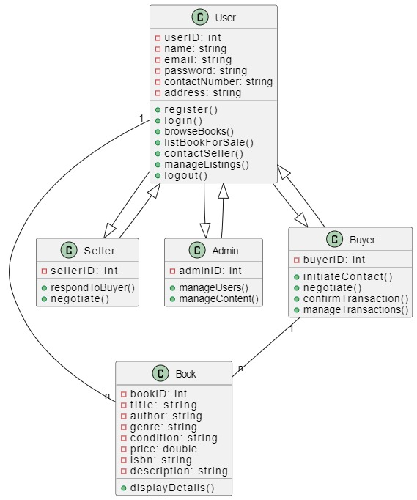
CLASS DIAGRAM

Slide 11
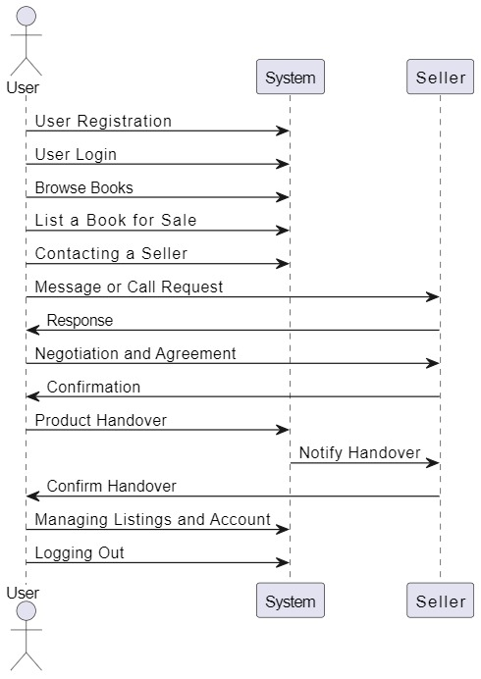
SEQUENCE DIAGRAM

Slide 12
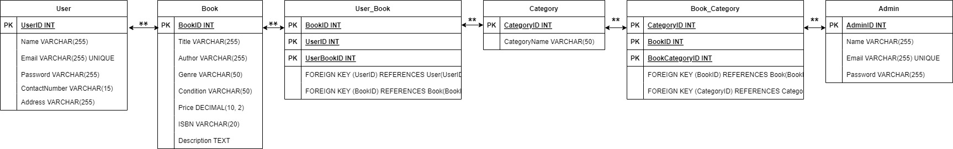
Er diagram

